Slide 1
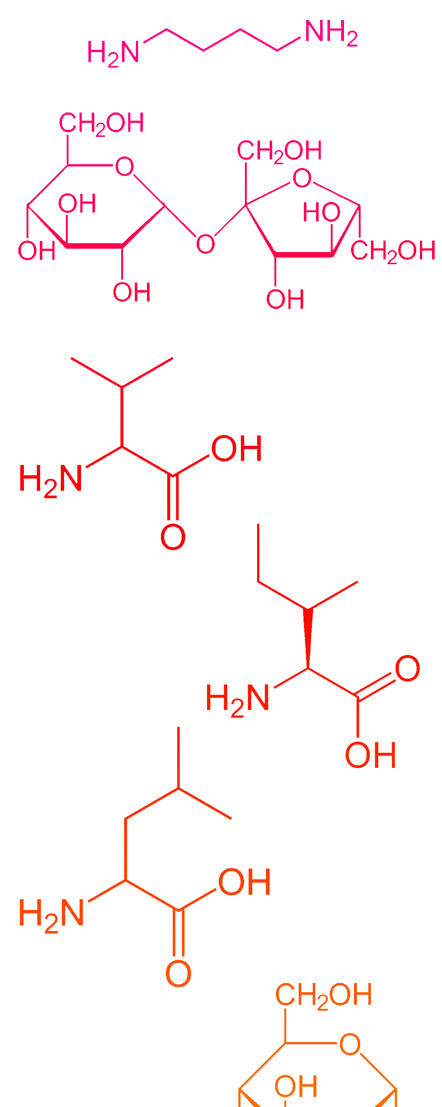
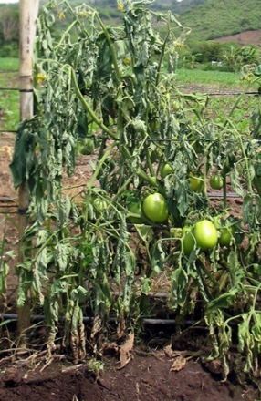
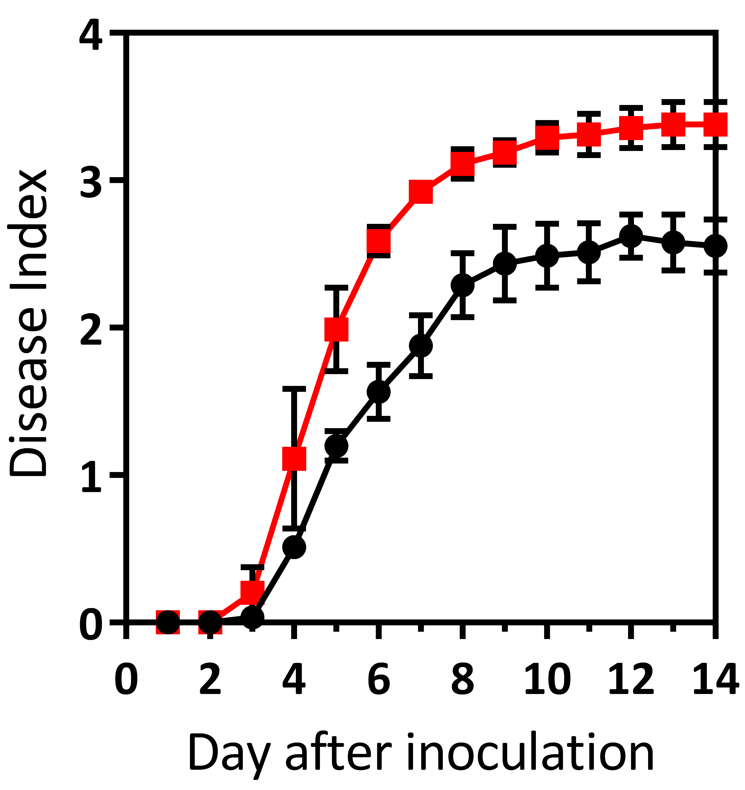
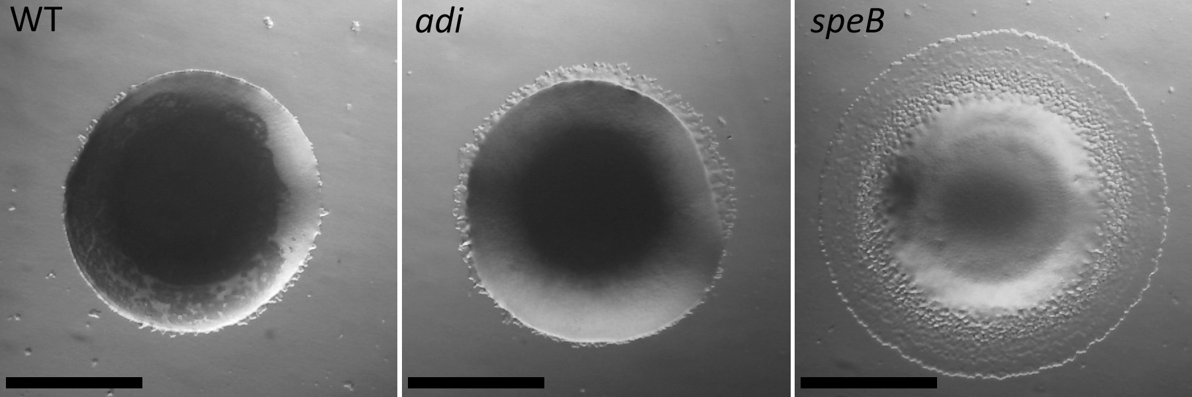
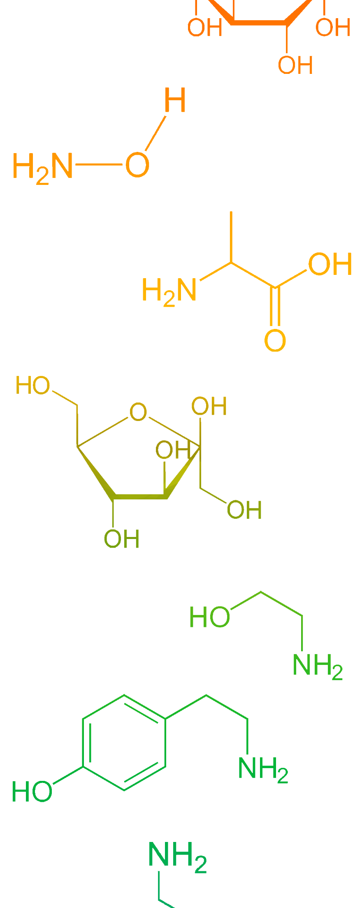
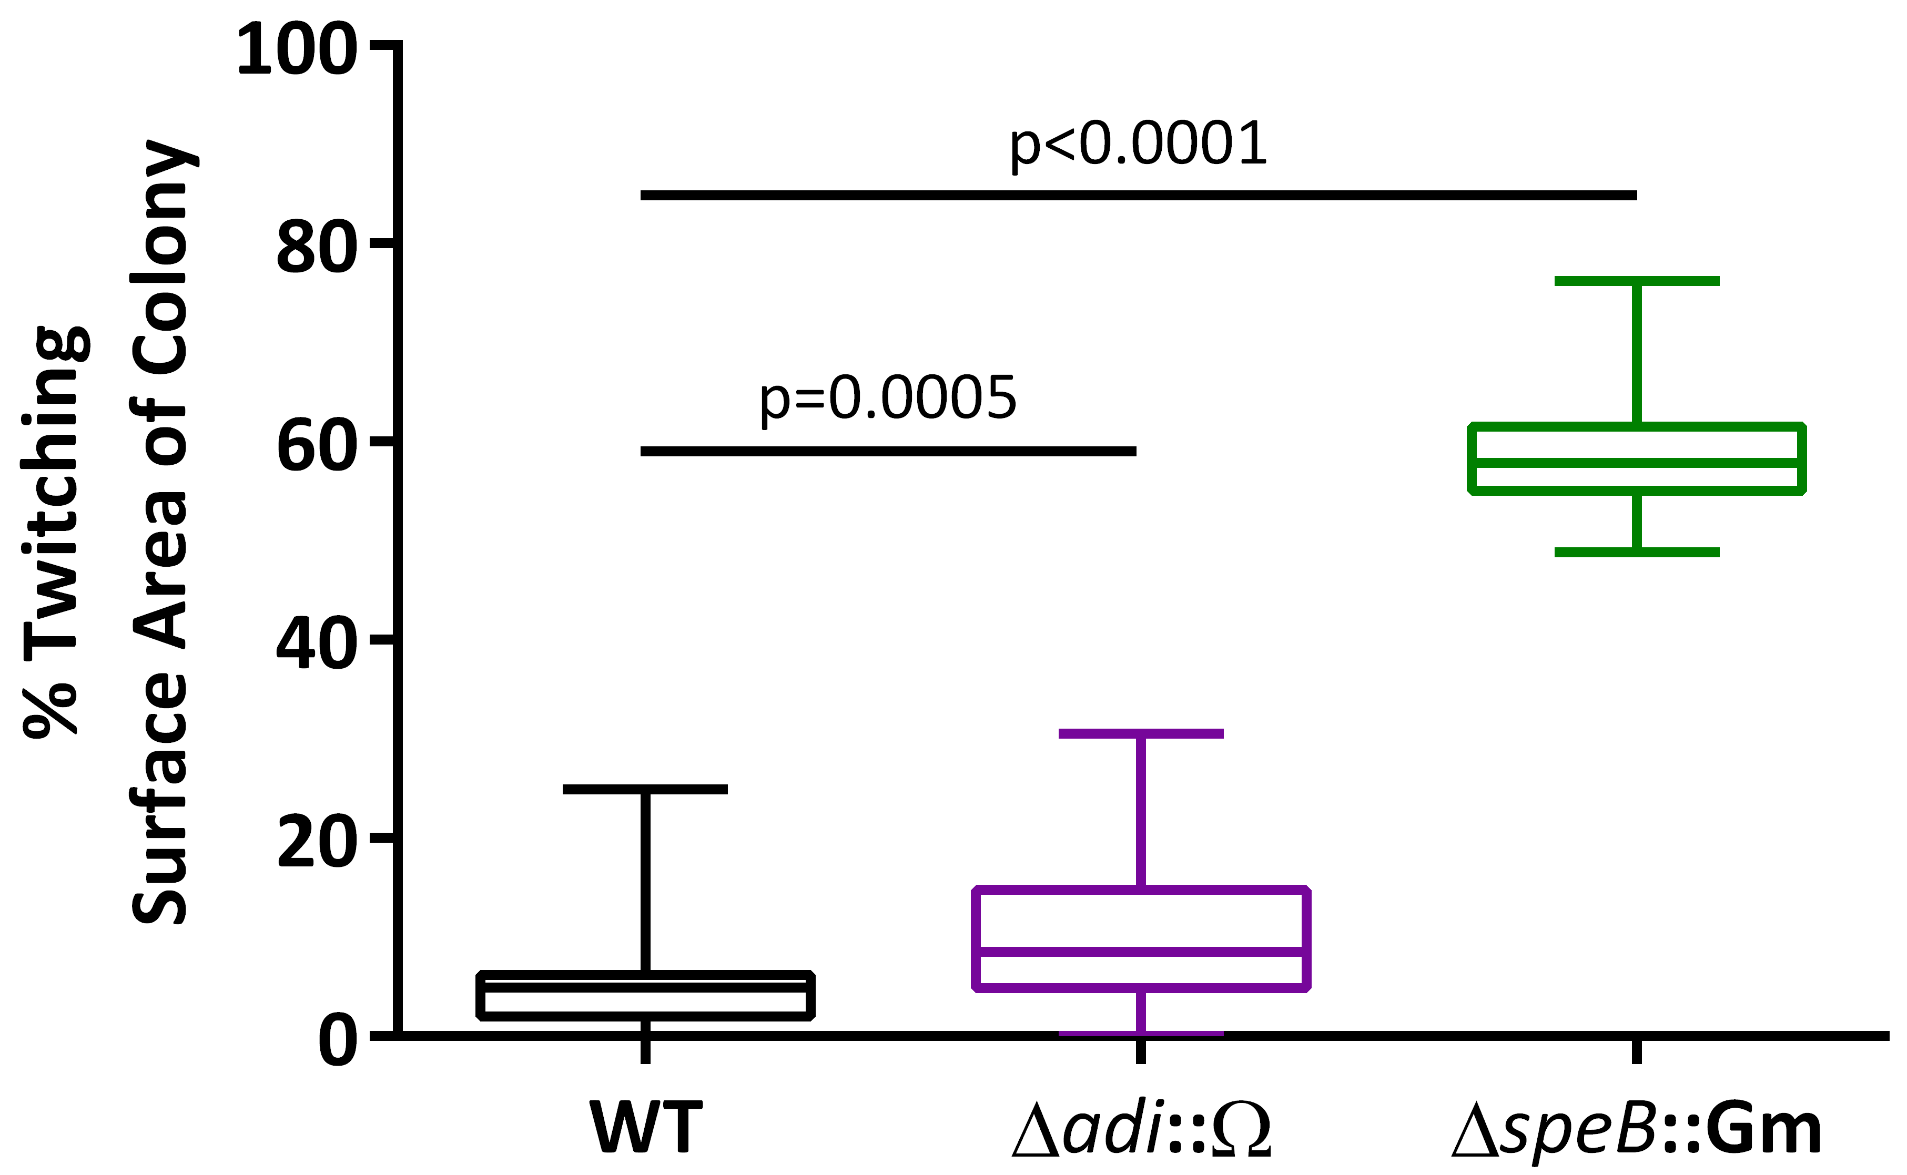

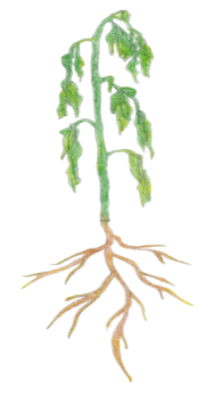
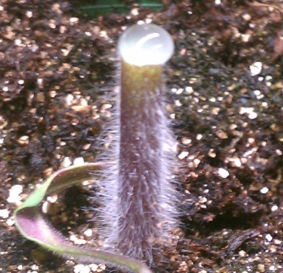
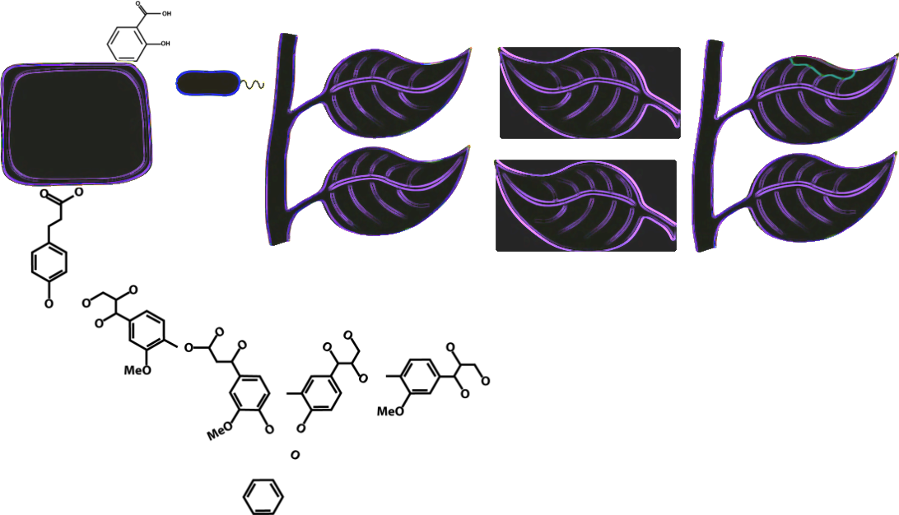
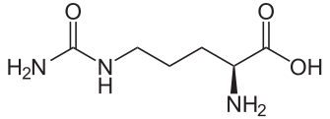
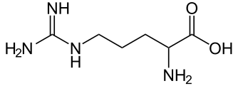
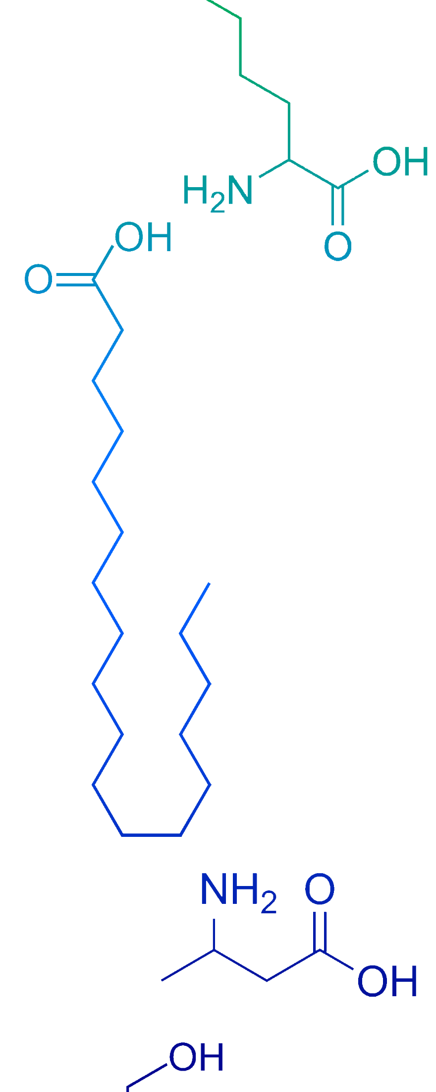


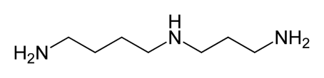

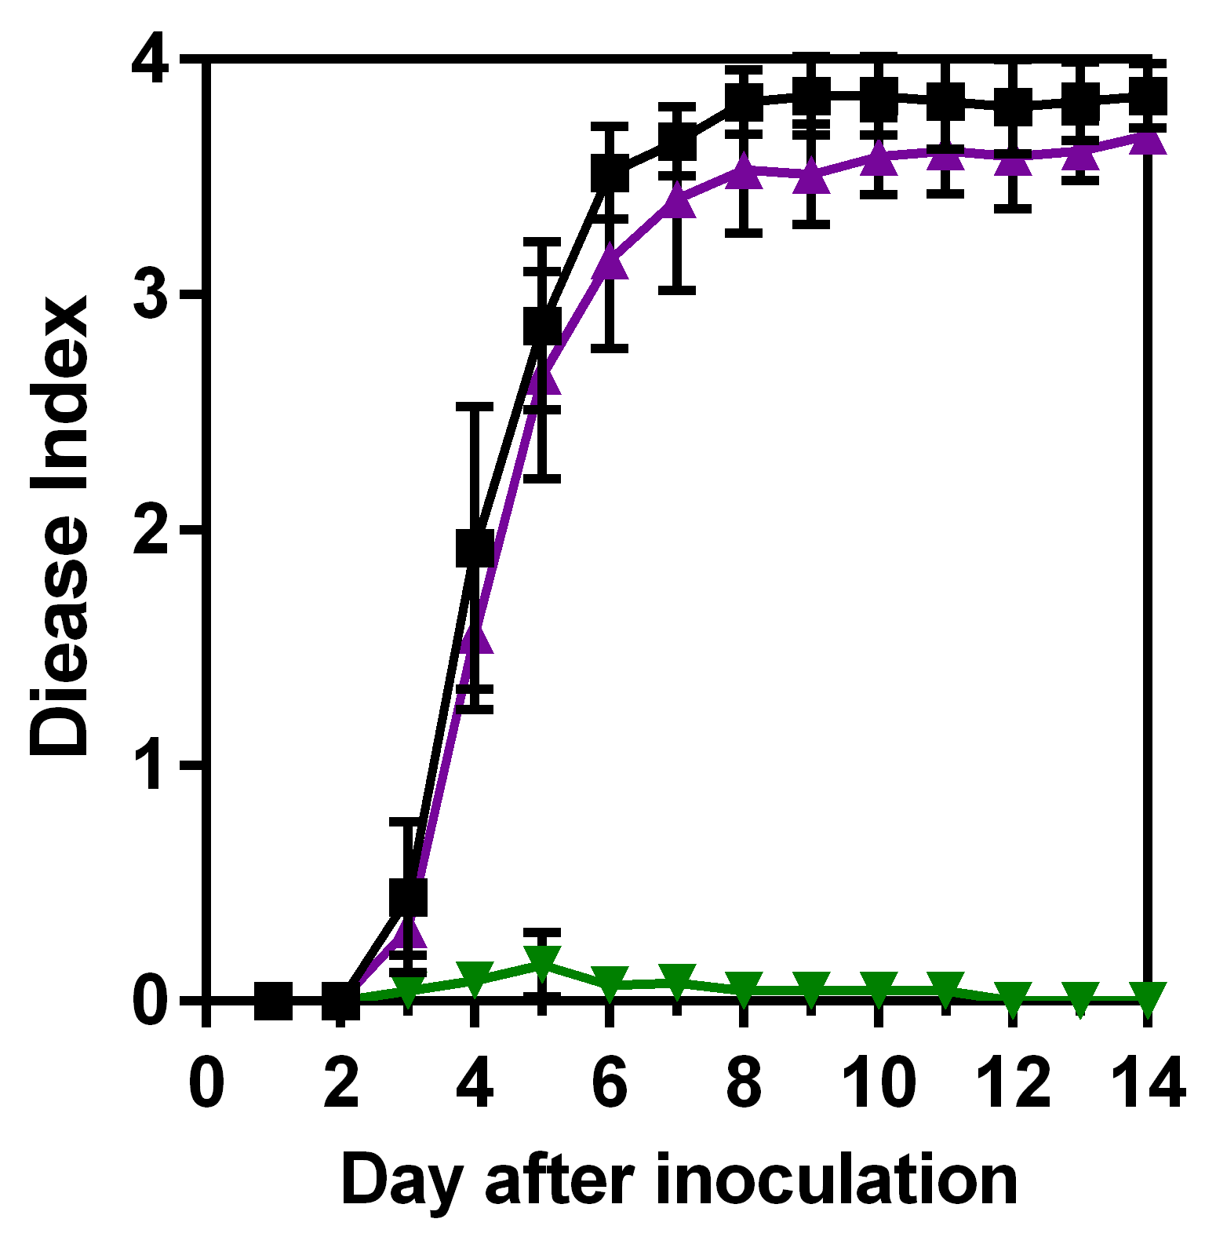
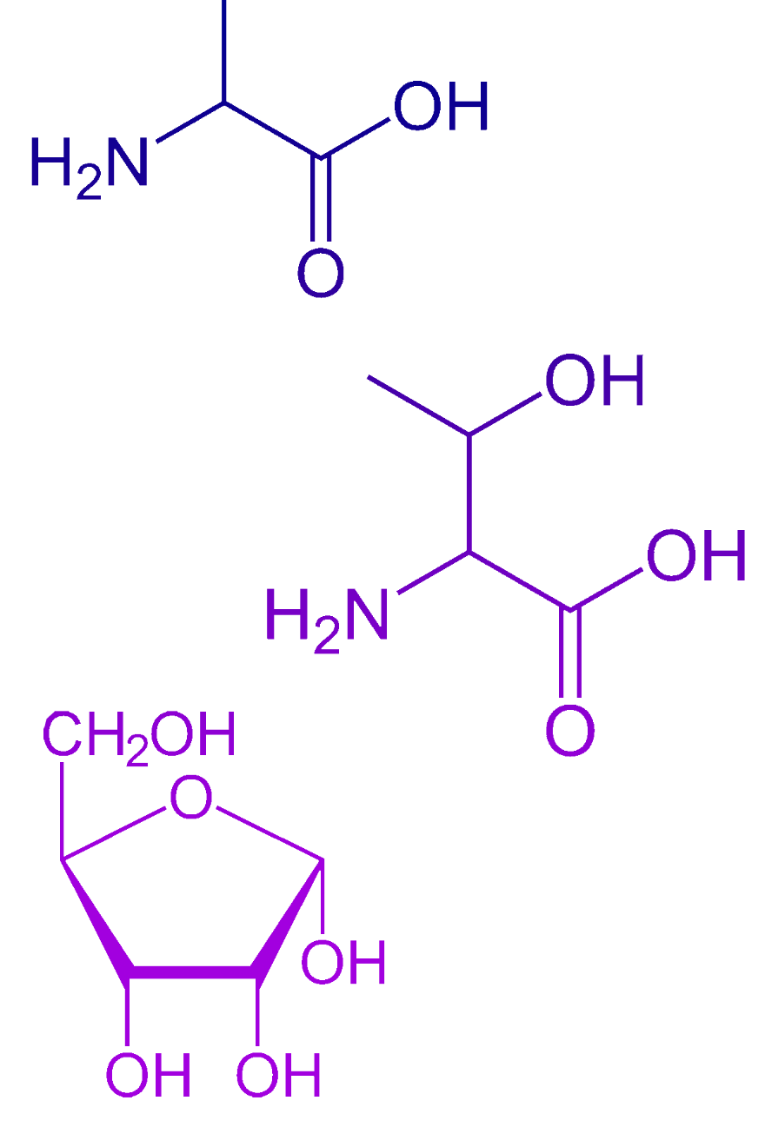




Metabolomics reveals putrescine is involved in Ralstonia solanacearum-host interactions
Tiffany M. Lowe, A. Jancewicz, P. Masson, Caitilyn Allen
University of Wisconsin—Madison
Editorial note: the “speB” mutant was incorrect.
Don’t trust this data. Read the 2018 paper to learn about Ralstonia/putrescine
Background: Bacterial wilt disease
Exogenous putrescine accelerates bacterial wilt disease
Putrescine biosynthesis mutants display increased twitching motility
Our Aim:
Use metabolomics to understand how Ralstonia solanacearum (Rs) grows so well in tomato xylem vessels
Experiment Overview:
WT
adi::Ω
speB::Gm
Experiment Overview:
Putrescine
Tomato plants were pre-treated with exogenous putrescine (0.5 mM) or water by spraying leaves to run-off and pouring 10 ml into soil
After 3 hr, plants were directly inoculated by placing 50 cells of wildtype bacteria onto a cut branch
Symptoms of each plant were rated daily on 0-4 scale corresponding to % wilted leaves
N=55 plants per condition; p<0.05 by repeated measures ANOVA
Strains were plated onto rich medium at ~100 CFU/plate
Plates were incubated at 28 °C with high humidity
The greatest differences in colony morphology were observed at 48 hpi (top).
ImageJ was used to quantify surface area (n>30 per strain).
Rs infects the water-transporting xylem vessels of many plants.
Large Rs populations (>10⁹ CFU/g stem) clog xylem vessels, leading to wilt.
Xylem sap is considered nutrient-poor.
Water
1 mm
Rs-infected tomato plant
p<0.05
Metabolomics of tomato xylem sap
Experiment Overview:
Twitching surface area (% of colony)
Twitching motility is a virulence factor (Liu et al., 2001)
Wildtype twitches only at low cell density (Liu et al., 2001)
Proposed explanation: ΔspeB::Gm mutation induces constitutive twitching motility and abnormal colony morphology
Healthy Tomato Plants
Plants were detopped, & xylem sap was harvested for 30 min.
GC-MS analysis at NIH-funded metabolomics core at UC-Davis (West Coast Metabolomics)
Sample size:
5 pools of 4 samples per condition
R. solanacearum expresses putrescine biosynthesis genes in planta
Proposed Arginine & Polyamine (e.g. Putrescine) Biosynthesis Pathway in Rs
Amount in
infected xylem sap
(peak height)
Absolute gene expression
in planta
(Jacobs et al., 2012)
Rs-Infected Tomato Plants
Urea Cycle
Detopped plant
458
Citrulline
Summary
34 compounds were enriched in infected xylem sap (p<0.05 by t-test; Fold Change>1.5)
succinate
argG
High
(12.02)
R. solanacearum infections increase concentrations of sugars and amino acids in tomato xylem sap
The polyamine putrescine is dramatically enriched (62-fold) in infected xylem sap
Exogenous putrescine accelerates disease progress in tomato
Genetically disrupting polyamine biosynthesis reduces R. solanacearum virulence on tomato
Polyamine biosynthesis mutants have altered colony morphology that suggests twitching motility is constitutively expressed in these strains
n.d.
Arginosuccinate
Medium
(9.72)
Putrescine
argH
n.d.
Arginine
adi
High
(11.57)
n.d.
Agmatine
speB
High
(11.38)
1,102,525
Putrescine
Low
(8.84)
speE
2,505
Spermidine
R. solanacearum putrescine biosynthesis contributes to virulence
n.d. = not detected
Future Directions
Δadi::Ω and ΔspeB::Gm mutants were created:
Biochemically confirm that adi and speB mutants produce less polyamines
Determine whether the increased putrescine in infected xylem sap is produced by R. solanacearum: quantify putrescine in sap from plants infected by WT vs. putrescine mutants.
Does constitutive expression of twitching motility cause the abnormal colony morphology in Δadi::Ω and ΔspeB::Gm mutants (i.e. does pilA deletion revert the phenotype)? If so, do polyamines affect the quorum-sensing regulator PhcA?
fdhD
dcd
adi
Hyp
argH
ABC
ABC
ABC
speB
TxnReg
Ω cassette
GmR
0.5 kb
Wildtype
Experiment Overview:
Δadi::Ω
Tomato plants were directly inoculated by placing 500 cells onto a cut branch.
Symptoms of each plant were rated daily on 0-4 scale corresponding to % wilted leaves
N=55 plants per strain; virulence of ΔspeB::Gm is significantly reduced compared to wildtype. p<0.05 repeated measures ANOVA
References and Acknowledgements
Jacobs, Babujee, Meng, Milling, & Allen. 2012. The In Planta Transcriptome of Ralstonia solanacearum: Conserved Physiological and Virulence Strategies during Bacterial Wilt of Tomato. mBio.
Liu, Kang, Genin, Schell, & Denny. 2001. Twitching Motility of Ralstonia solanacearum Requires a Type IV Pilus System. Microbiol.
Hypothesis: R. solanacearum-produced putrescine in tomato xylem sap contributes to virulence
ΔspeB::Gm
TML and AJ were supported by NIH National Research Service Award T32 GM07215
This project was supported by the Agriculture and Food Research Initiative Competitive Grant No. 2015-67011-22799 from the USDA National Institute of Food and Agriculture
Travel to ASM-GM 2015 was supported by an ASM Student Travel Award

